Slide 1
DW Final Project
Group 1
Anshu Raina
Haince Pen
Monica Mantri
Sindhu Srinivasan

Slide 2
Contents
I. Data Mart Design Definition
1. Universe of Discourse
2. Information Package
II. Dimensional Model
III. Data Staging: ETL – Data Extract File Definitions
IV. Data Staging: ETL – Source-to-Target Mappings
V. SQL Code – Tables & Constraints
VI. Data Staging Activities - ETL
1. Data Cleansing
2. Data Transformation
3. Table Population
VII. End User Applications
1. Queries
2. Materialized Views & Summaries
VIII. Handling Slowly Changing Dimensions (SCD)
IX. N-M Implementation Option

Slide 3
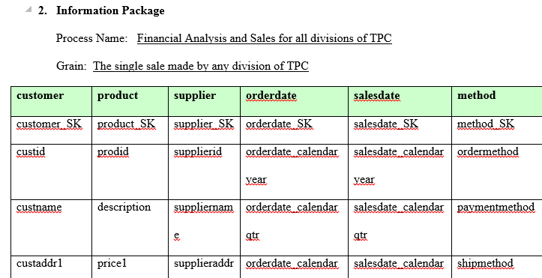

Data Mart Design Definition
1. Universe of discourse
For this data mart is financial analysis and control for all divisions of TPC, namely TPC-E, TPC-W and PEC, including sales by divisions to external clients as well as among themselves over year, quarter, month & day.
Scope
Sales and manufacturing of products by each division of TPC to external clients as well as among themselves over year, quarter, month or day.

Slide 4
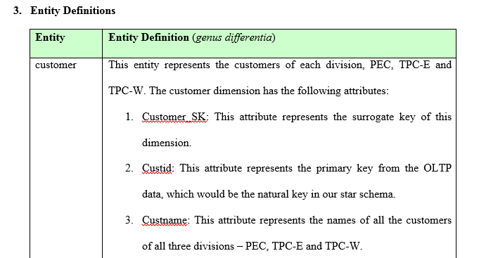
Data Mart Design Definition
Customer
Product
Supplier
SalesDate
OrderDate
Method
Product_Sale (Fact)

Slide 5
Data Mart Design Definition
Product_Sales (Fact table)
All SKs and 2 facts:
Gross Profit
Daystocompleteorder
Gross profit = Sale Price – Cost price for the transaction
Sale Price = price1 or price2 * qty
Where price 1 – sale price when discounted = 0
Where price 2 – sale price when discounted = 1
Cost Price = [(Manufacturing cost for a month, year for that productId)/(aggregation of qty that productId sold for that month and year)] * qty;
Daystocompleteorder
SaleDate - OrderDate

Slide 6
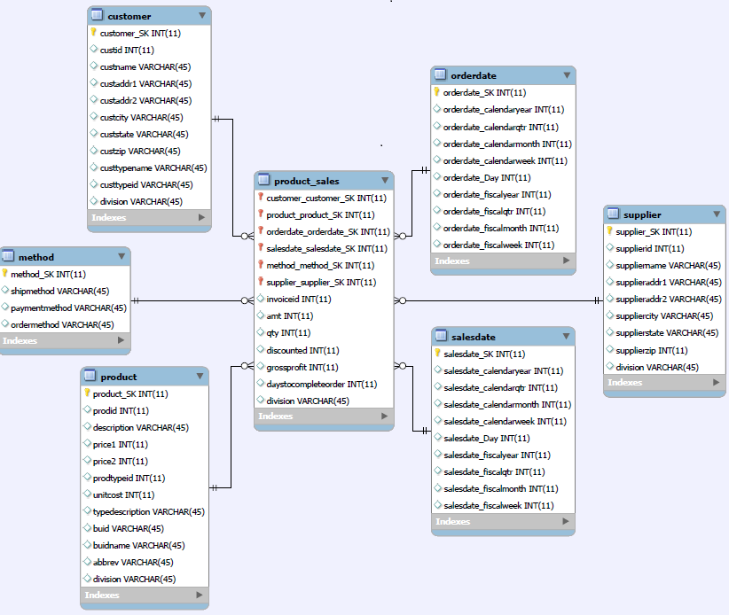
Dimensional Model

Slide 7
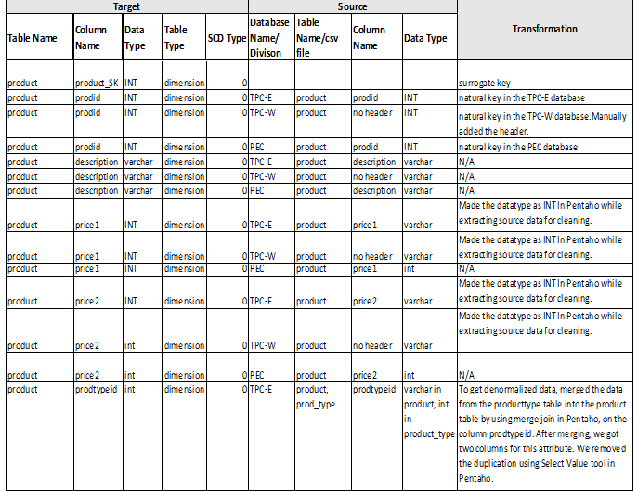
Data Staging: ETL – Source-to-Target Mappings
Retrieved from http://users.itk.ppke.hu/~szoer/DW/Kimball%20&%20Caserta%20-The%20Data%20Warehouse%20ETL%20Toolkit%20%5BWiley%202004%5D.pdf

Slide 8
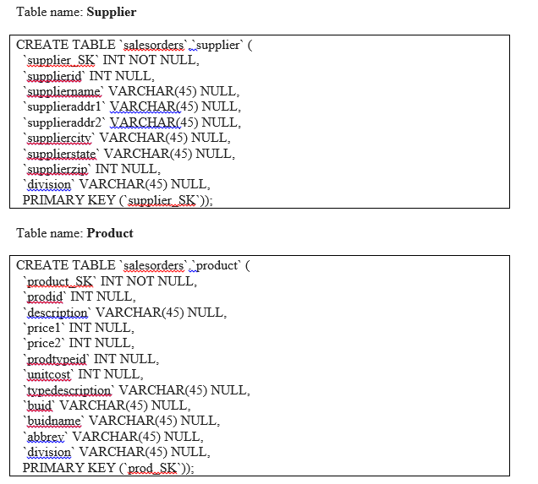
SQL Code – Tables & Constraints

Slide 9
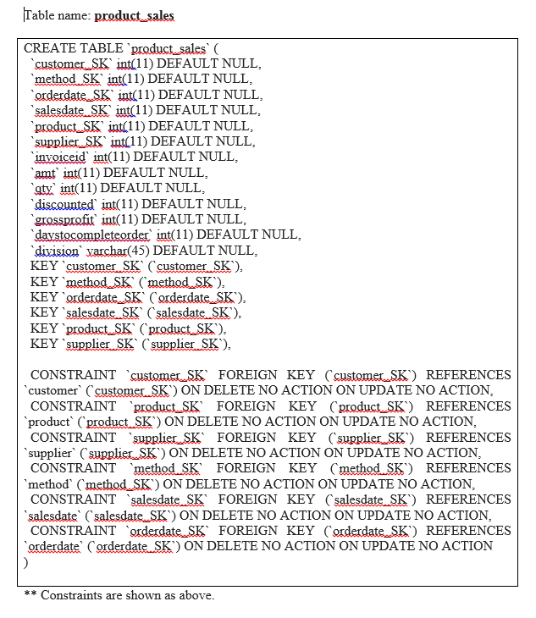
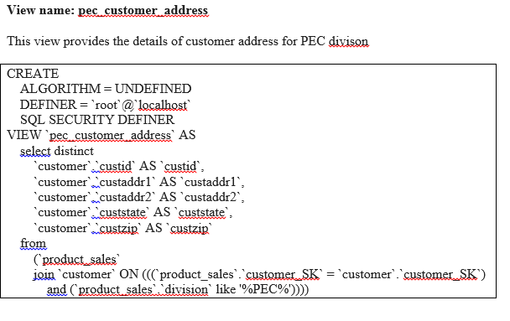
SQL Code – Tables & Constraints

Slide 10
Data Staging Activities - ETL
DATA CLEANING
DATA TRANFORMATION
DATA LOADING

Slide 11
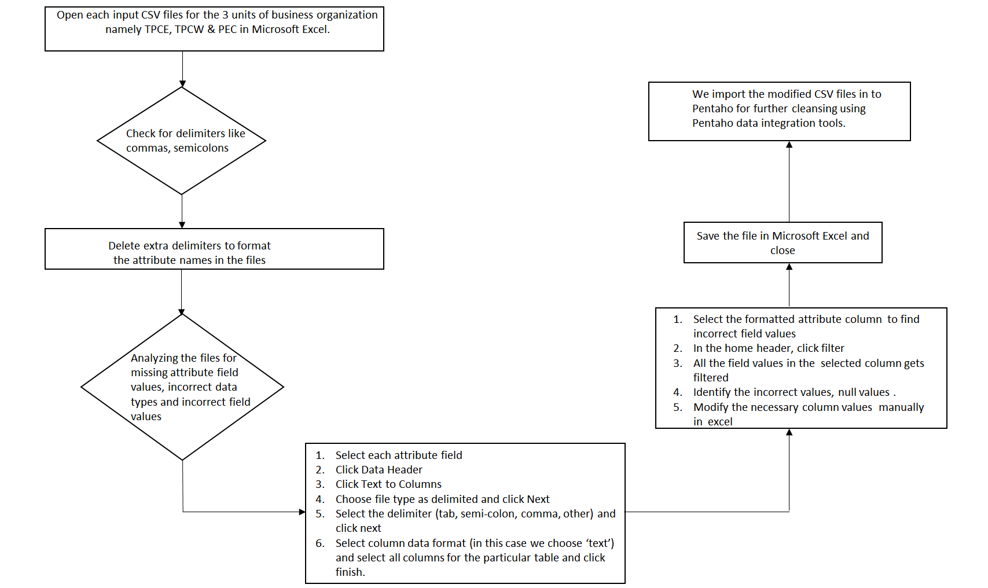
DATA CLEANSING

Slide 12
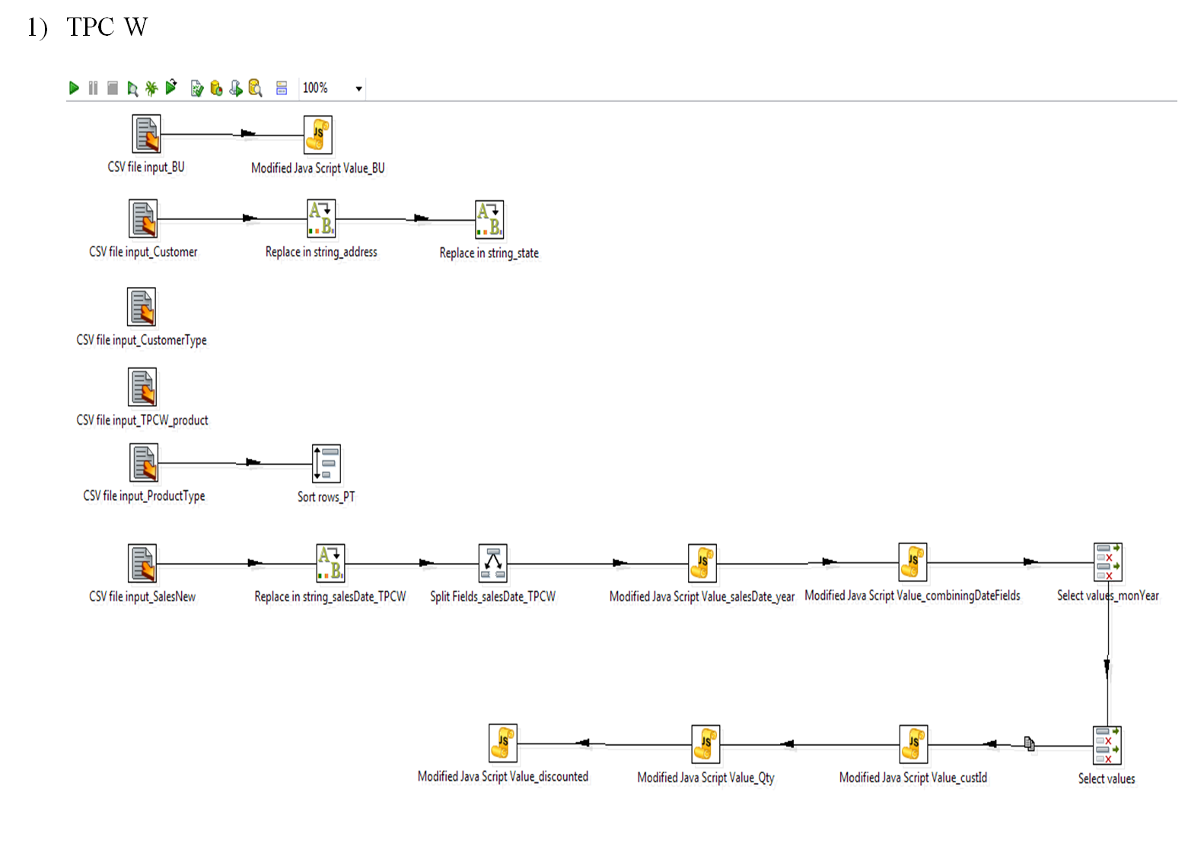
DATA CLEANSING
Pentaho Kettle

Slide 13
DATA CLEANSING
Microsoft Excel
Inc.,
Corp
Incorporated,
Corporation
Empty Address field values
Substituted with ‘Suite #111’

Slide 14
DATA TRANSFORMATION
For TPC E, TPC W and PEC, merged the clean output files wherever needed using Pentaho to de-normalize the schema.
e.g- Customer + Customertype = Customer Dimension
For TPC E, TPC W and PEC, checked the attribute names were consistent for all the csv files.

Slide 15

DATA TRANSFORMATION
After having clean data from each department, we created a consolidated Microsoft Excel file for each division using the VLOOKUP formula. The VLOOKUP formula is as follows:
VLOOKUP( A2,[entire table to be looked upon ] ,integer value, False)
TPCE_consolidated.csv
TPCW_consolidated.csv
PEC_consolidated.csv

Slide 16
TABLE POPULATION
TPCE_consolidated.csv
STAGING TABLE in MySQL WORKBENCH
PEC_consolidated.csv
TPW_consolidated.csv

Slide 17
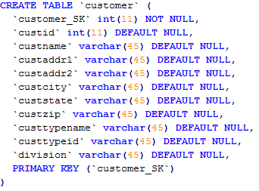

TABLE POPULATION
We created dimension tables in MySQL by extracting the details from the staging table and populated it sequentially for all the divisions namely TPCE, TPCW and PEC.
Syntax for creating the dimension table:

Slide 18
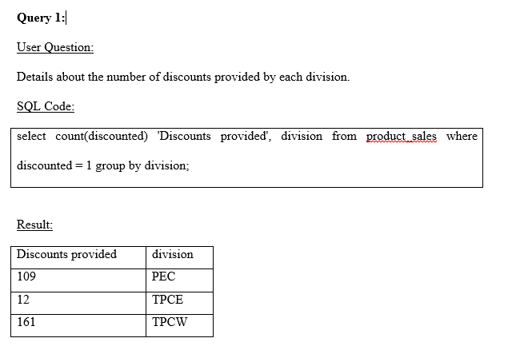
End User Applications

Slide 19
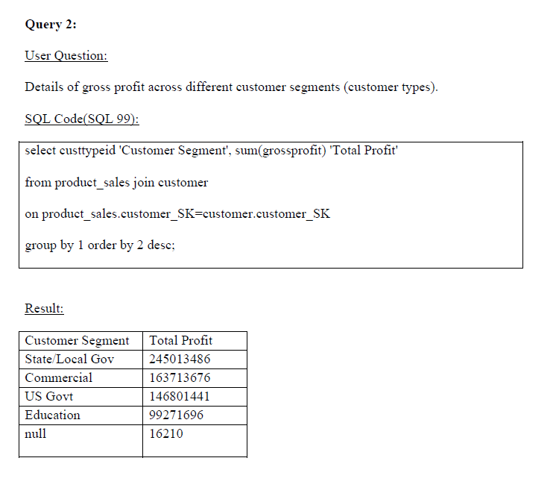
End User Applications

Slide 20
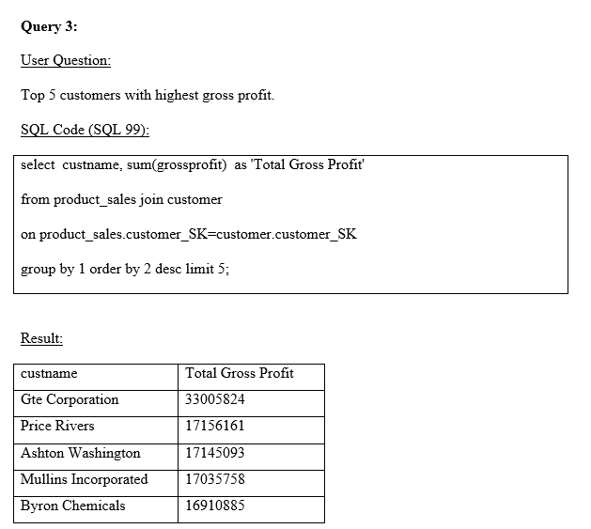
End User Applications

Slide 21
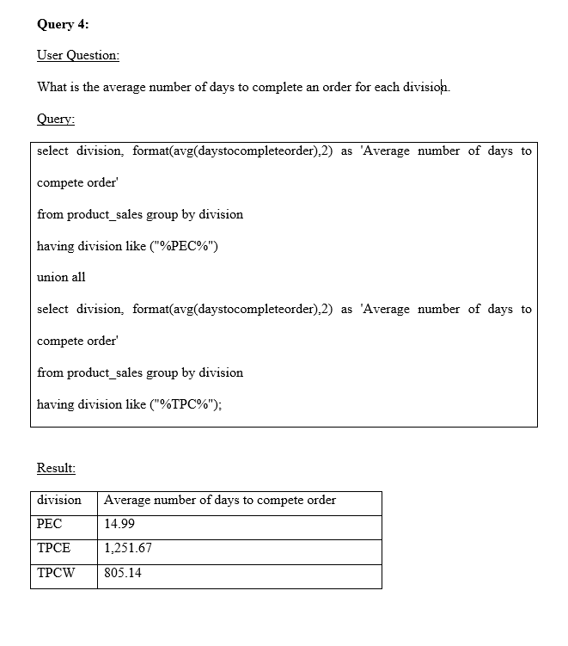
End User Applications

Slide 22
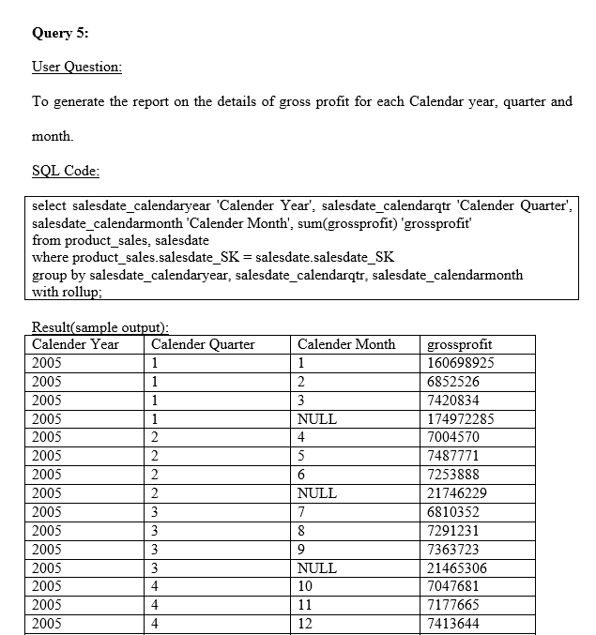
End User Applications

Slide 23
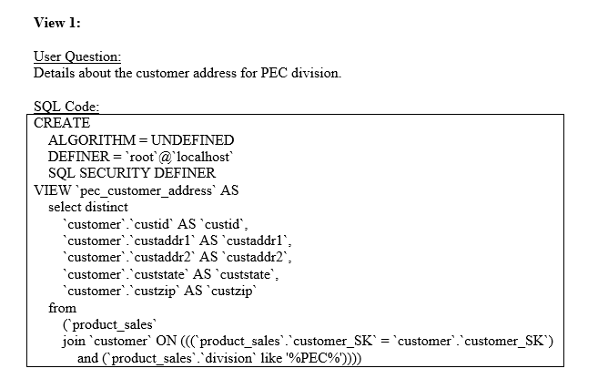
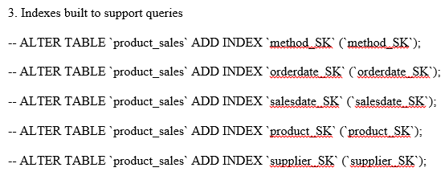
Views & Summaries

Slide 24
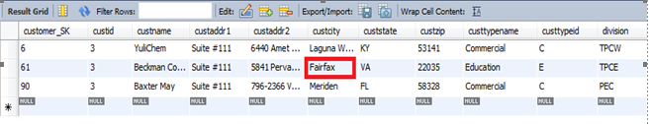

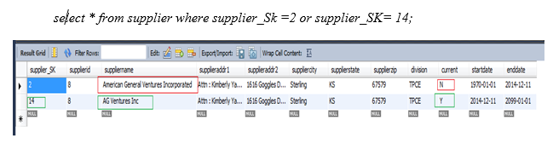
SCD’s & Implementation
SCD Type1
Fairfax → Fairport
SCD Type 2

Slide 25
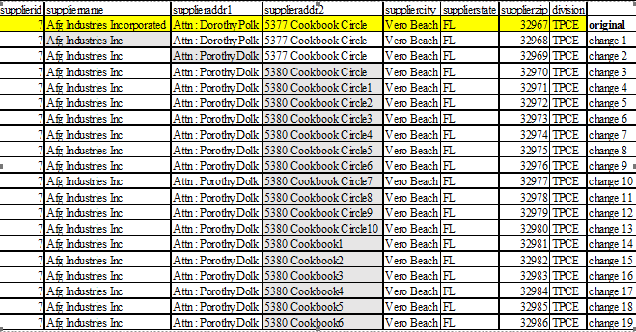
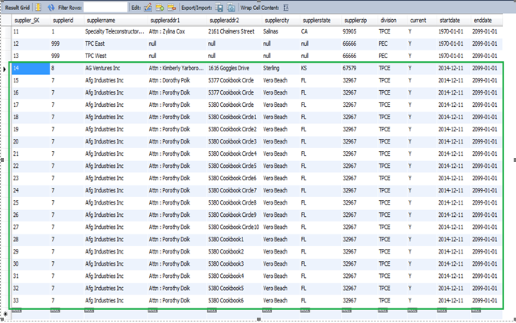
Similarly we implemented SCD type 2 and 19 rows were generated

Slide 26
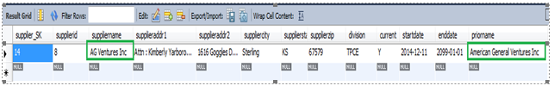
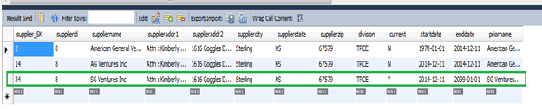
SCD Type 3
SCD Type 6

Slide 27
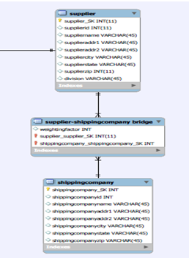
Many-to-Many (N-M) Relationship Implementation Option
Bridge table approach

Slide 28
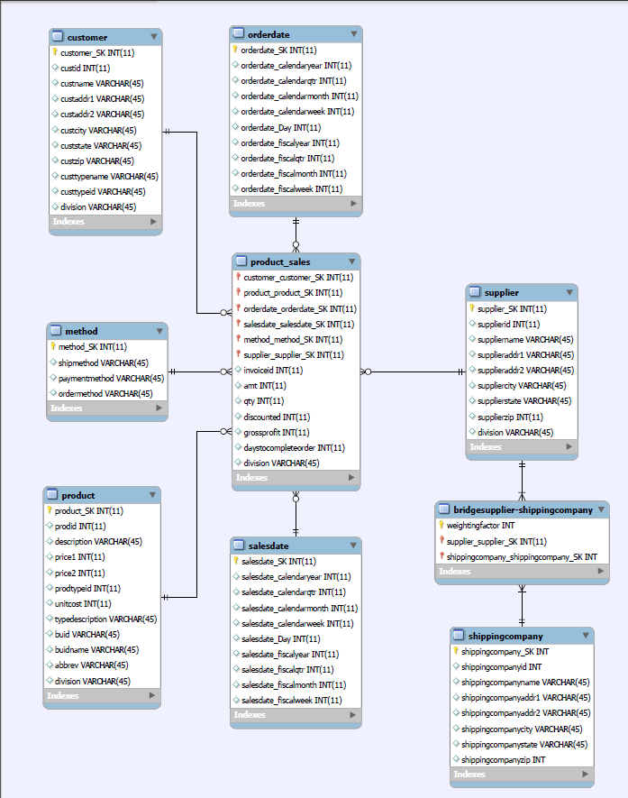
Many-to-Many (N-M) Relationship

Slide 29
Tableau Demonstration & results

Slide 30
References
[1] Design Tip #166 Potential Bridge (Table) Detours | Kimball Group. (n.d.). Retrieved from http://www.kimballgroup.com/2014/05/design-tip-166-potential-bridge-table-detours.
[2] Retrieved from http://intranet.cis.drexel.edu:8080/faculty/song/publications/p_Song_M_N_DMDW_final.pdf
[3] Retrieved from http://users.itk.ppke.hu/~szoer/DW/Kimball%20&%20Caserta%20-The%20Data%20Warehouse%20ETL%20Toolkit%20%5BWiley%202004%5D.pdf

Slide 31
Thank You !!

